Slide 1
Displaying Categorical Data

Slide 2
Displaying Categorical Variables
Have you ever seen a picture created from a table of data?
Can you think of a situation when you would want to take a table and produce an image?

Slide 3
Displaying Categorical Variables
# pie-chart :: (t :: Table, col :: String) → Image
pie-chart(animals-table, "legs")
What is the Name of this function?
How many inputs are in its Domain?

Slide 4
Displaying Categorical Variables
# pie-chart :: (t :: Table, col :: String) → Image
pie-chart(animals-table, "legs")
Click run.
Then type pie-chart(animals-table, "legs")
and hit Enter.
What happens?

Slide 5
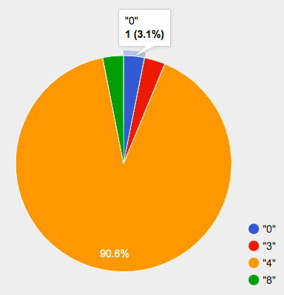
Displaying Categorical Variables
Hovering over a pie slice reveals the label, as well as the count and the percentage of the whole. In this example we see that there is 1 animal with 0 legs, representing 3.1% of the population
We can also resize the window by dragging its borders. This allows us to experiment with the data before closing the window and generating the final, non-interactive image.

Slide 6
Displaying Categorical Variables
The function pie-chart consumes a Table of data, along with the name of a categorical column you want to display. The computer goes through the column, counting the number of times that each value appears.
Then it draws a pie slice for each value, with the size of the slice being the percentage of times it appears. In this example, we used our animals-table table as our dataset, and made a pie chart showing the distribution of the number of legs across the shelter.

Slide 7

Breakout
Here is the Contract for another function:
Use bar-chart to make a display showing how many animals there are of each species.
Experiment with pie/bar charts, passing in different column names. If you get an error message, read it carefully!
What do you think are the rules for what kinds of columns can be used by bar-chart and pie-chart?
When would you want to use one chart instead of another?
Make sure you have a spokesperson for your group
# bar-chart :: (t :: Table, col :: String) → Image
10min

Slide 8
Displaying Categorical Variables
What did you discover as you explored?
When would you use a bar-chart vs pie-chart?
Notes:
Debrief the activity with the class. What kind of value was produced by that expression? (An Image! New datatype!) Which error messages were helpful? Which ones weren’t?

Slide 9
Displaying Categorical Variables
Pie charts and bar charts are mostly used to display categorical data.
While bars in some bar charts should follow some logical order (alphabetical, small-medium-large, etc), the pie slices and bars in these charts can technically be placed in any order, without changing the meaning of the chart.

Slide 10
Displaying Categorical Variables
To dig deeper into pie charts and bar charts, have students turn to
Pie Chart - Notice and Wonder
Bar Chart - Notice and Wonder
Bar & Pie Chart - Notice and Wonder
Matching Bar Charts to Pie Charts

Slide 11
Exploring other Displays
There are lots of other functions, for all different kinds of charts and plots.
Even if you don’t know what these plots are for yet, see if you can use your knowledge of Contracts to figure out how to use them.
Complete Exploring Displays and (More) Exploring Displays.

Slide 12
Exploring other Displays
What did you find?
What is your favorite type of display?
Are there any displays you’ve never seen before?
Notes:
Today you’ve added more functions to your toolbox. Functions like pie-chart and bar-chart can be used to visually display data, and even transform entire tables!
You will have many opportunities to use these concepts in this course, by writing programs to answer data science questions.

Slide 13
Other Graphs
Practice Plotting
Making Infographics
Making Infographics Rubric

